Slide 1



Slide 2


Introduction
Fahad Masood Tax Consultancy was founded in 2016. Clients from all around UAE trust the services provided by our company. We consist of smart working team of Chartered Accountants dealing as Tax consultants in Abu Dhabi and is a Certiﬁed Chartered Accountant Organization providing VAT Consultancy, VAT Accounting, Bookkeeping, Internal Audit, Financial consultation services to companies of all sizes. When you allow us to serve you, we take the job seriously and do whatever it takes to make sure that you get the best services and also make sure that your conﬁdential information remains secure.

Slide 3



VAT Services
Registration with service tax
Filing of regular service tax returns and other compliances Calculation of service tax
Bookkeeping Services
Recording of accounting transactions Reconciliation of Ledgers
Maintenance of Cash book, Fixed Asset Register, etc.
SERVICES WE PROVIDE
Finance & Accounting Service
Coordinating with Auditors Cash Flow Analysis
Proﬁt Reporting
Business Consultancy
Liquidation Business Setup Company Formation

Slide 4



Internal Audit
Help protect your assets and reduce possibilities of frauds Increase ﬁnancial reliability and integrity
Establish monitoring procedures
SERVICES WE PROVIDE
Financial Analysis
Determining your proﬁt margin Determine key areas of investment
Determine the upcoming risk and its mitigations
Risk Management
Regulatory Compliance
Governance, Compliance and Control Risk (ICRF) Infrastructure

Slide 5
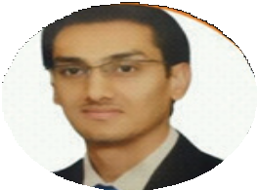
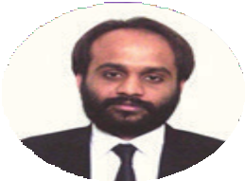
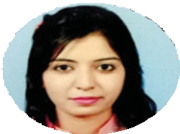
FAHAD MASOOD
KHAWAJA ABSAR HAFEEZ
YEARS EXPERIENCE WITH AUDIT & ASSURANCE
YEARS TEACHING EXPERIENCE
SANAULLAH CHARTERED ACCOUNTANTS & CO HABIB BANK LTD.
MIRCHAWALA HUB OF ACCOUNTANCY
Founder & CEO
FAHAD MASOOD TAX
OUR STAFF
TALAL HASSAN
ACCA
SENIOR TAXATION ASSOCIATE
5 YEARS EXPERIENCE TAXATION AND AUDIT & ASSURANCE
SANAULLAH CHARTERED ACCOUNTANTS & CO
URWAH RAGHIB
ACCA
SENIOR AUDITOR
3 YEARS EXPERIENCE IN AUDIT & ASSURANCE
A.M LALIWALA CHARTERED ACCOUNTANT & Co

Slide 6








Our Clients

Slide 7

THANK
YOU

